Slide 1
PCB WORKSHOP
BY LUIS DANIEL PAMBID
KYLE MARC COTEJO

Slide 2
What is PCB?
PCB is a acronym of Printed Circuit Board that helps in connecting the electronics components with pads, tracks and lines incorporated on a laminated copper sheet.

Slide 3
LiveWire
Designing and simulating software
Hundreds of other components
Easy to use
Free to download

Slide 4
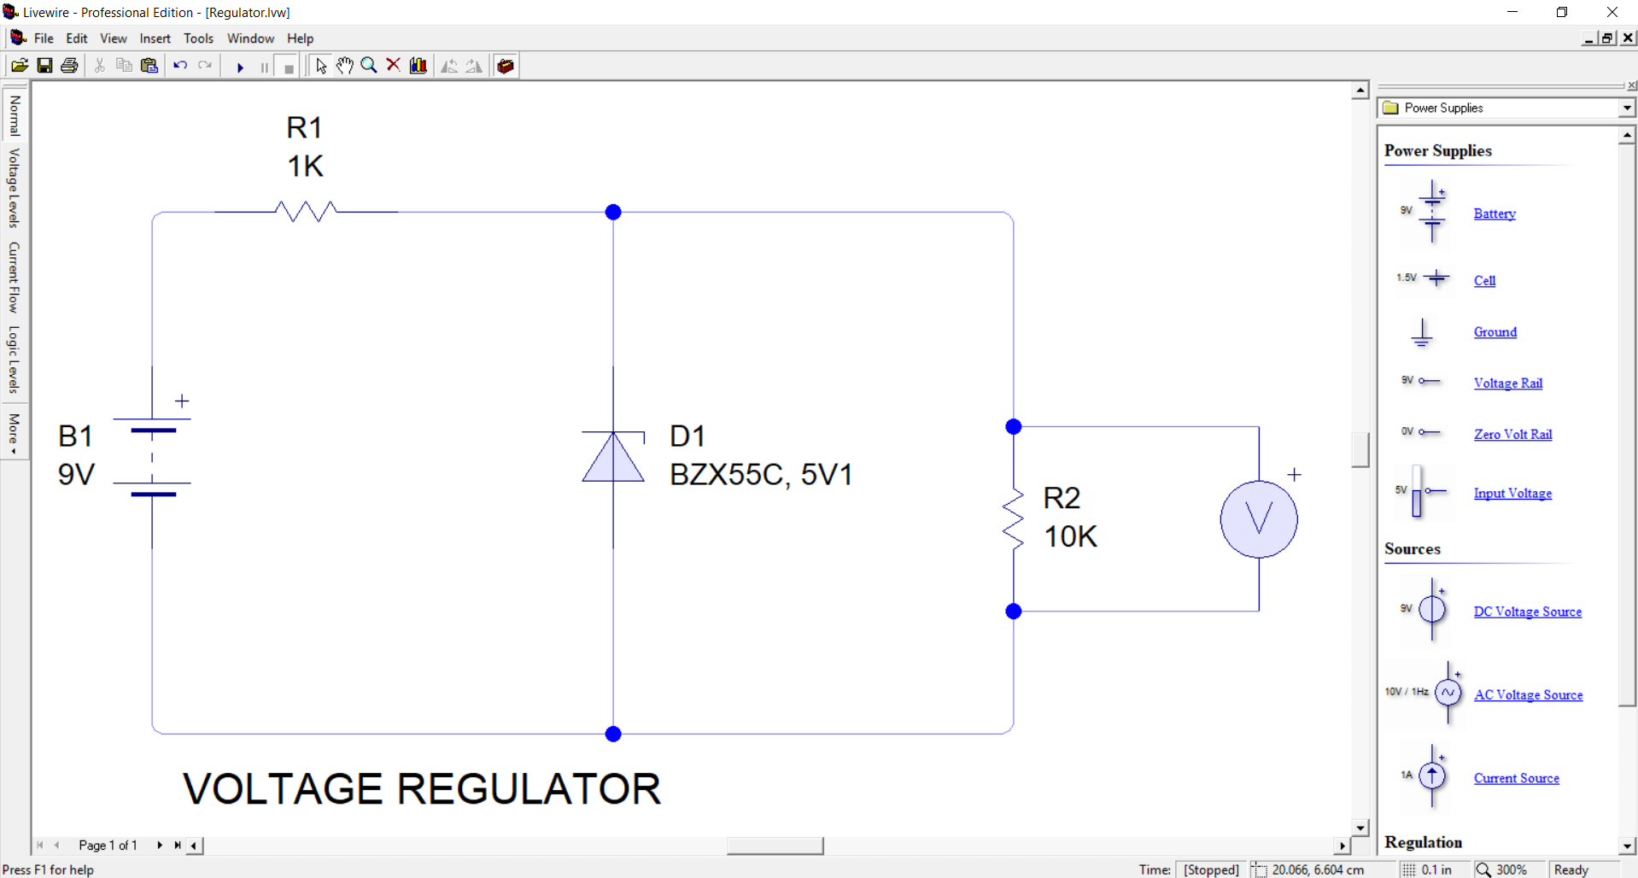
Design Mode

Slide 5
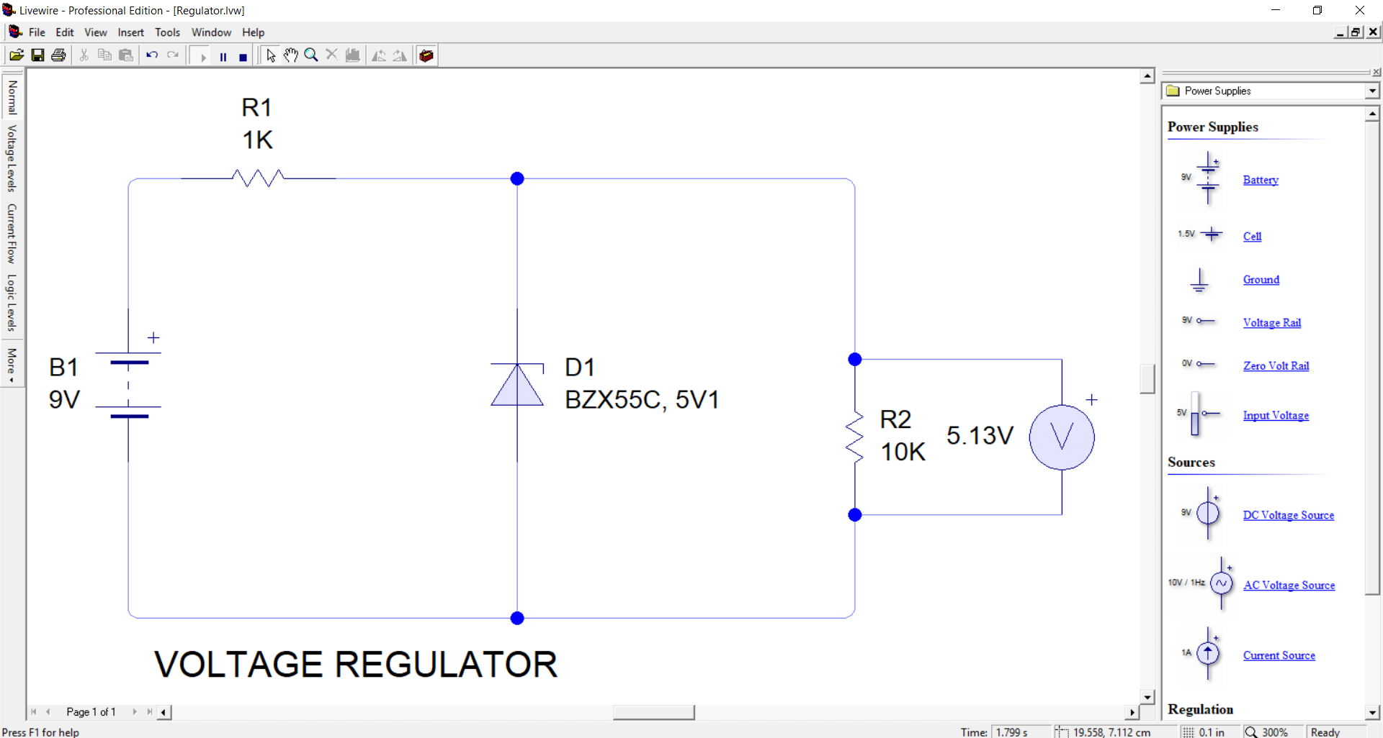
Simulation Mode

Slide 6
PCBWiz
Designing PCB
Single-Sided & Double-Sided
Auto-route feature
Free to download

Slide 7
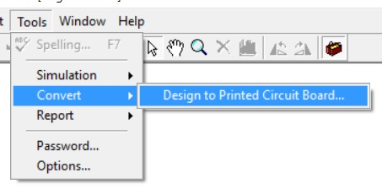
LiveWire to PCBWiz
WARNING:
PCB Wizard Software must be open before converting to PCB.

Slide 8
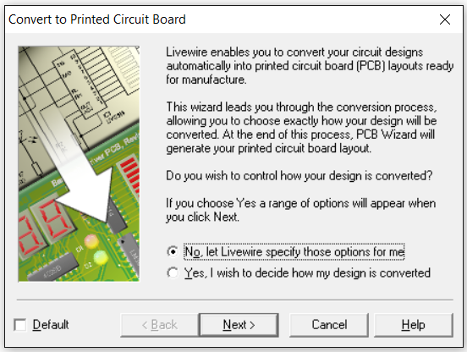
Convert to PCB

Slide 9
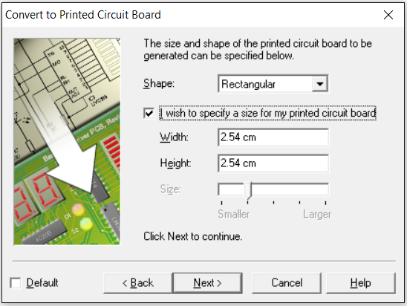
Convert to PCB

Slide 10
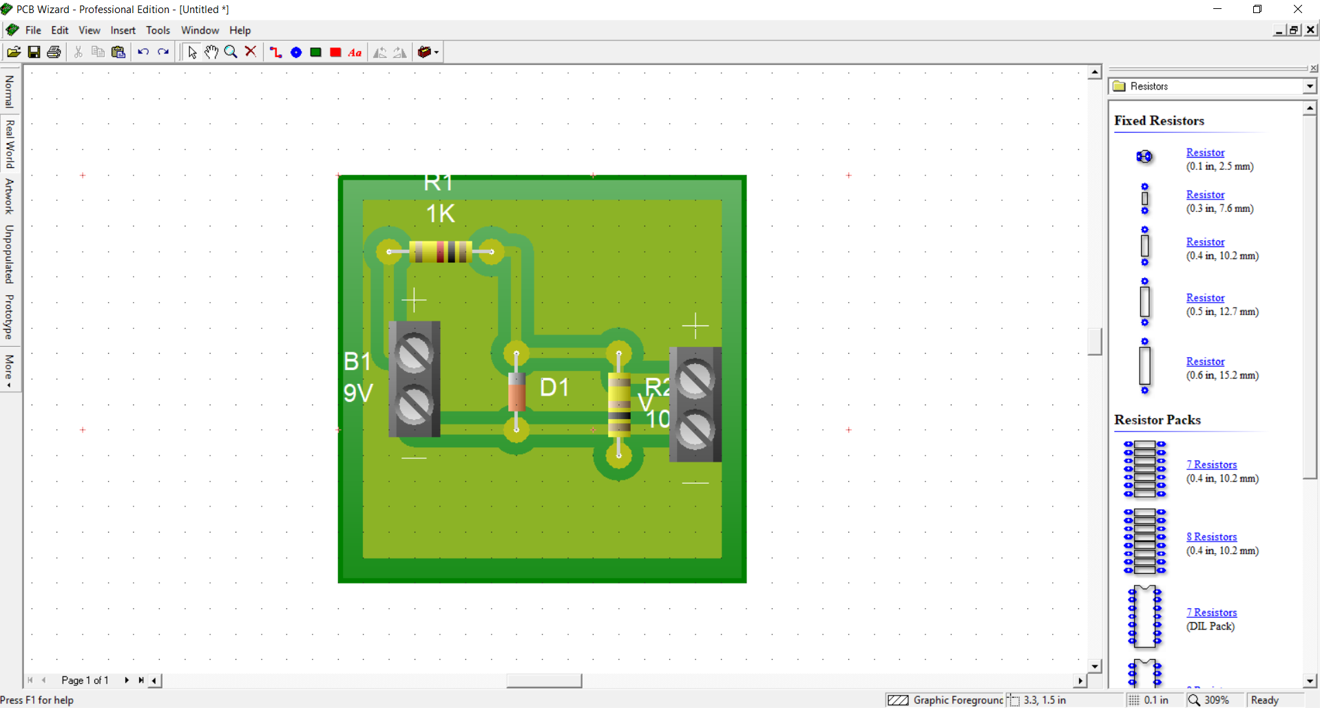
PCBWiz

Slide 11
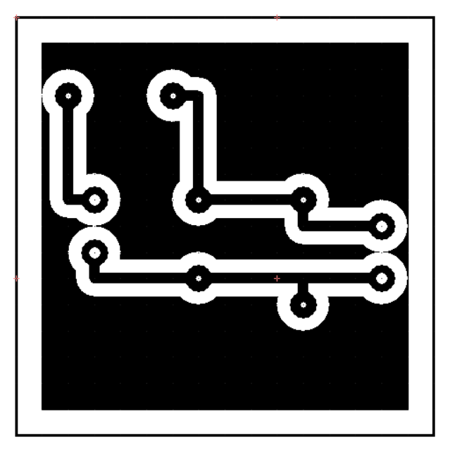
PCBWiz
ARTWORK MODE - ito yung gagamitin natin sa UV Exposure process.

Slide 12
STEPS IN DOING PCB:
UV EXPOSURE
DEVELOPING – yung parang shabu
ETCHING – pag-gamit ng Ferric Chloride
DRILLING
ASSEMBLY OF COMPONENTS
SOLDERING
TROUBLESHOOTING

